Slide 1

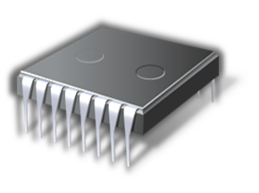


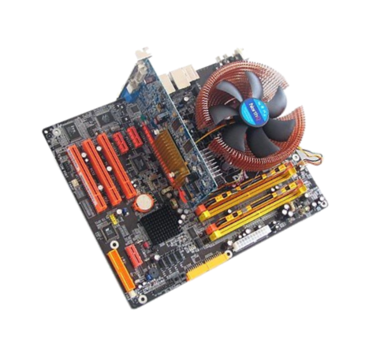

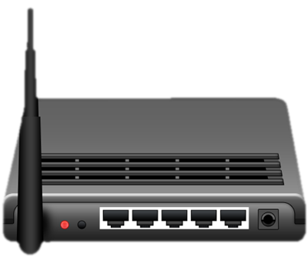
1 - Hardware
Marian Marinov
CEO of 1H Ltd.
mm@1h.com
Stoyan Stoyanov
System Administrator
sto [ at ] softuni.bg

Slide 2
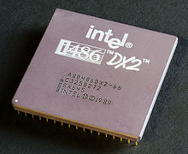
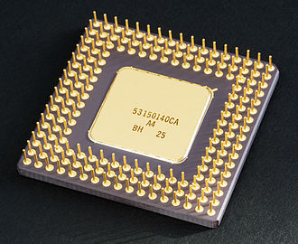
What is a CPU?
A miniature calculator
A lot of transistors
A very fast clock

Slide 3
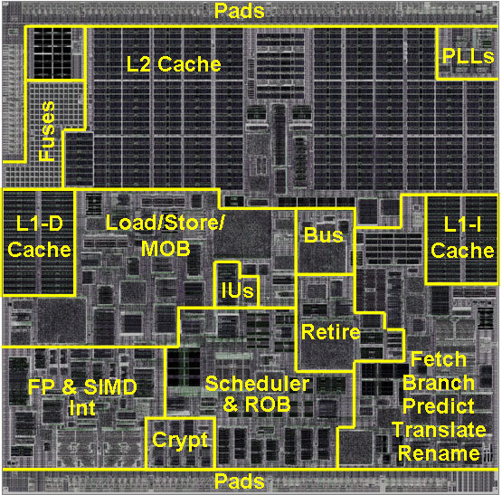
CPU Architectures
Reduced Instruction Set Computing - RISC
MIPS, SPARC, Alpha, ARM, AVR, PowerPC, PA-RISC
Complex Instruction Set Computing - CISC
x86, x86-64, VAX, m68k, System /360/370/Z
Caches
Little/Big Endian
Threading model
32/64bit

Slide 4
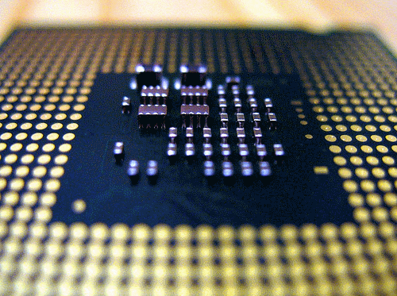
CPU Instruction Sets
LOAD
STORE
ADD
MOVE
PUSH
POP
Single operand instruction sets
Multiple operand instruction sets

Slide 5

CPU Endianness
149 in binary
Big Endian
Most significant bit is last – 03 E8
SPARC, PowerPC
Little Endian
Least significant bit is last – E8 03
Intel x84 / x64
Bi-endian – ARM (little by default)

Slide 6
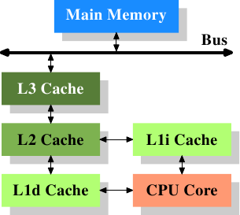
CPU Caches

Slide 7
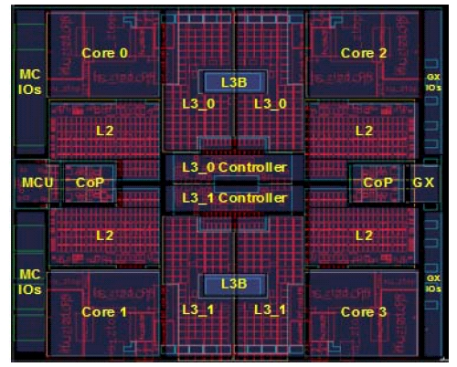
CPU Caches

Slide 8
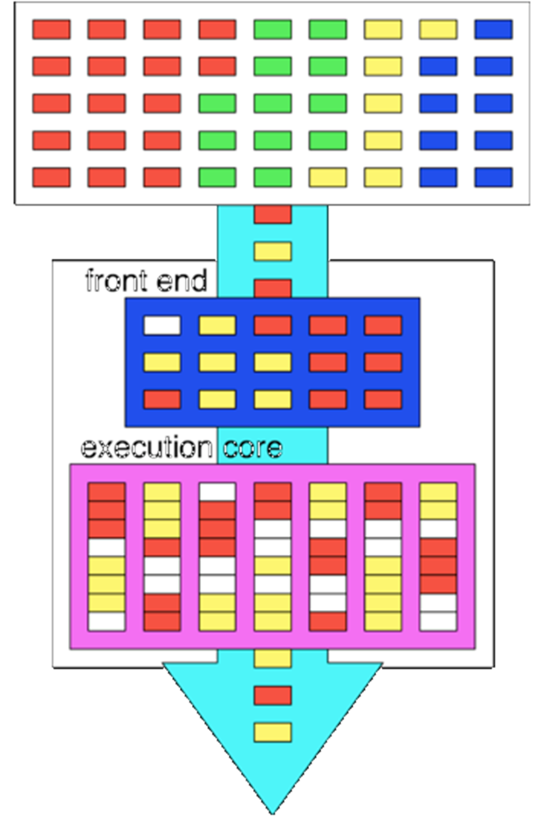
CPU Threads
Thread is a chain of
instructions in the CPU
Multithreading
Hyperthreading

Slide 9
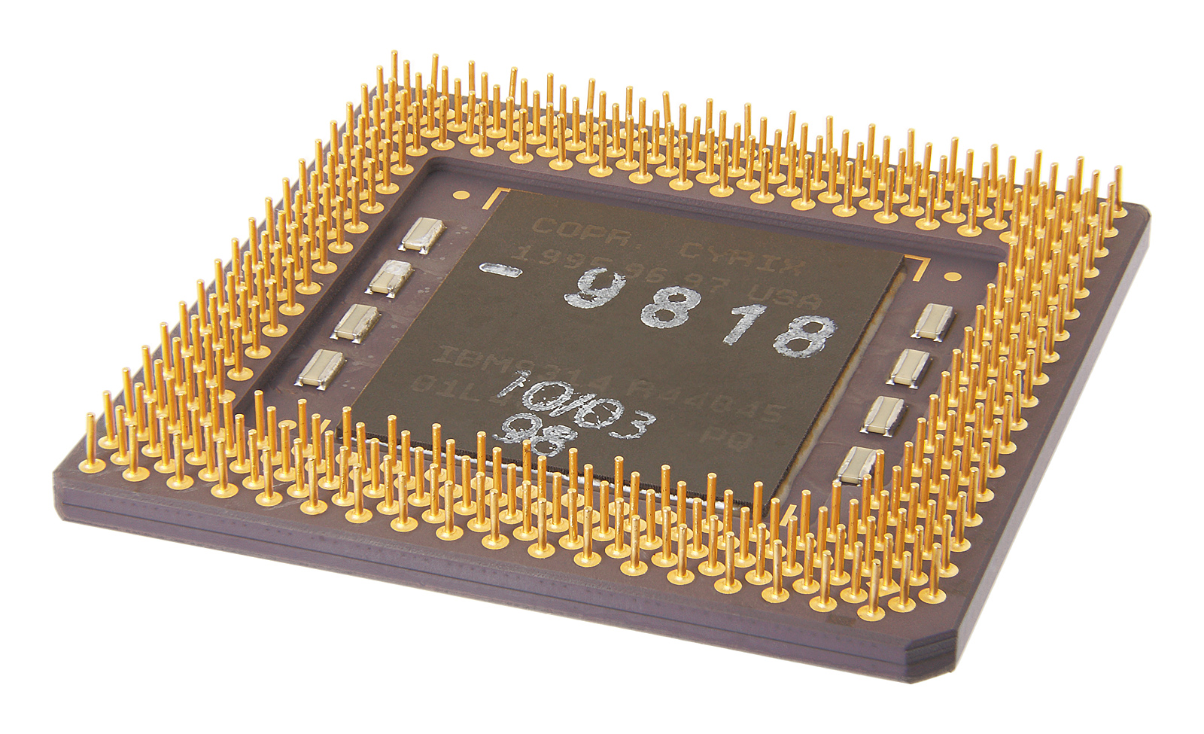
CPU 32/64bit
A 32-bit register can store 2³² different values
0 through 4,294,967,295 unsigned integers
A 64-bit register can store 2⁶⁴
Actual memory addresses that can be accessed by a single CPU thread

Slide 10
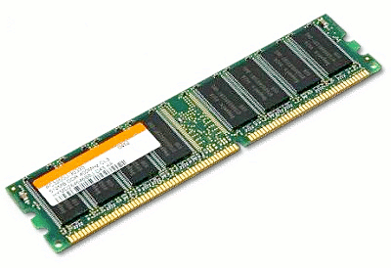
Memory
Volatile memory – SRAM/DRAM
System memory
Non-volatile memory – NVRAM/FLASH/ROM
BIOS
Firmware chips
Solid State Drives

Slide 11
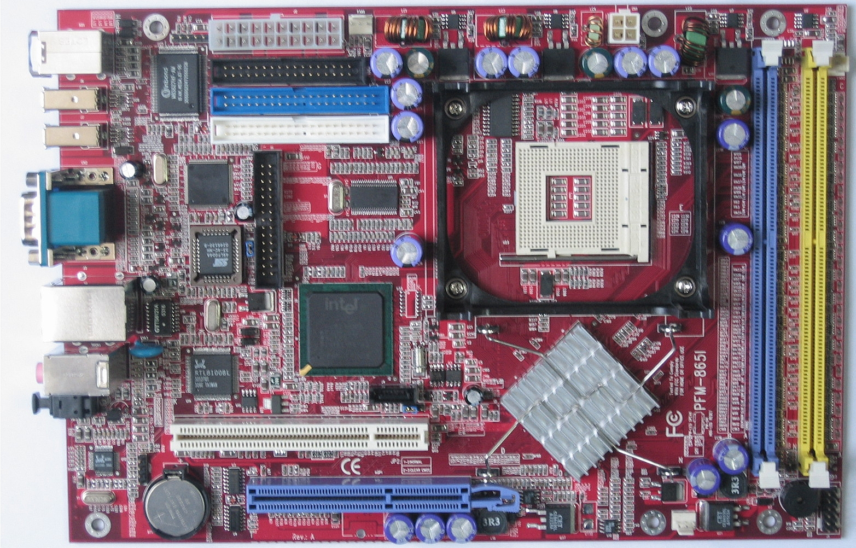
Mainboard
Power connector
Memory
Sockets
CPU Socket
IDE/PATA
connectors
NORTHBRIDGE
SOUTHBRIDGE

Slide 12
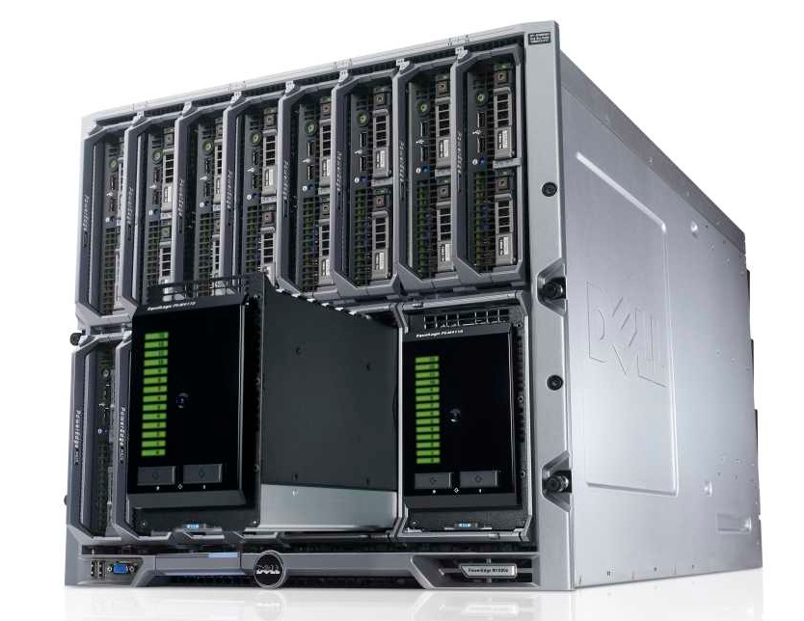
Storage
Controller
RAID
Devices
IDE/PATA
SCSI
SATA
SAS
SSD

Slide 13
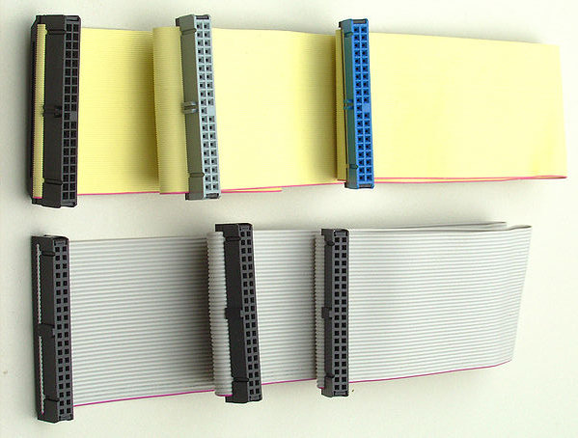
PATA / IDE

Slide 14
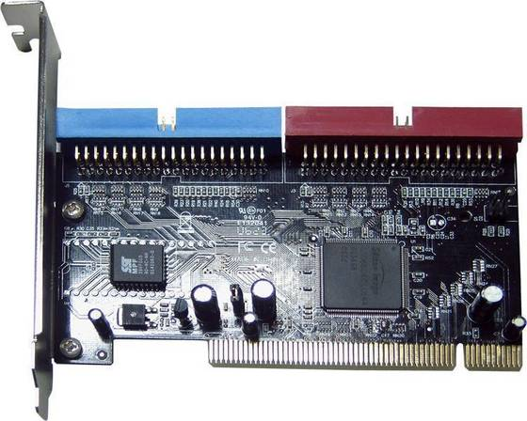
PATA / IDE

Slide 15
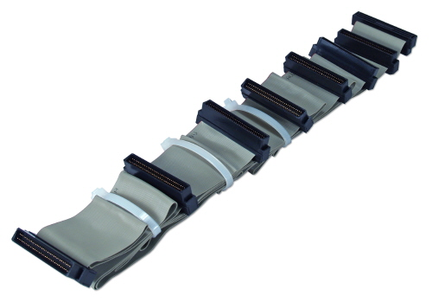
SCSI
Limited by length

Slide 16
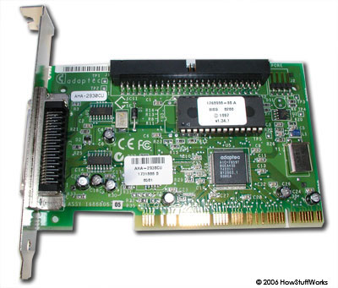
SCSI

Slide 17
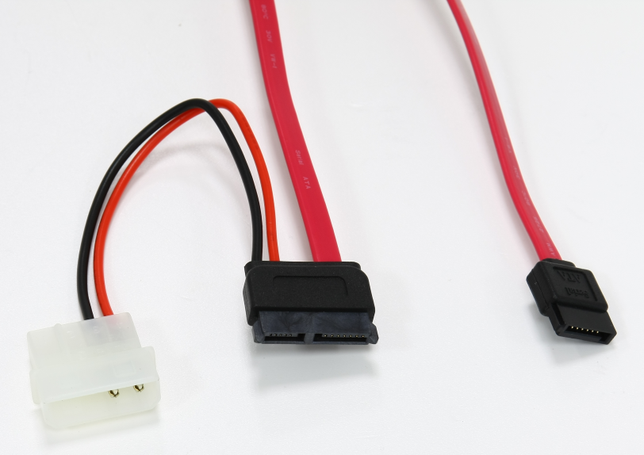
Serial ATA

Slide 18
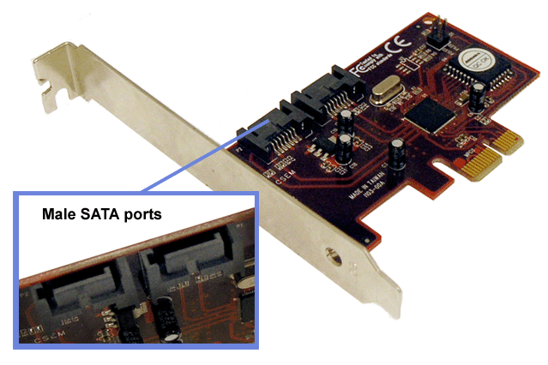
Serial ATA

Slide 19
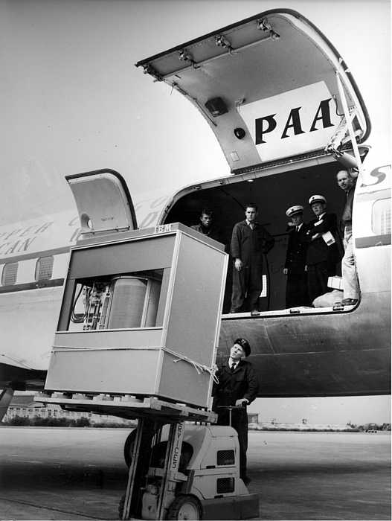
Year: 1956
Size: 5MB

Slide 20
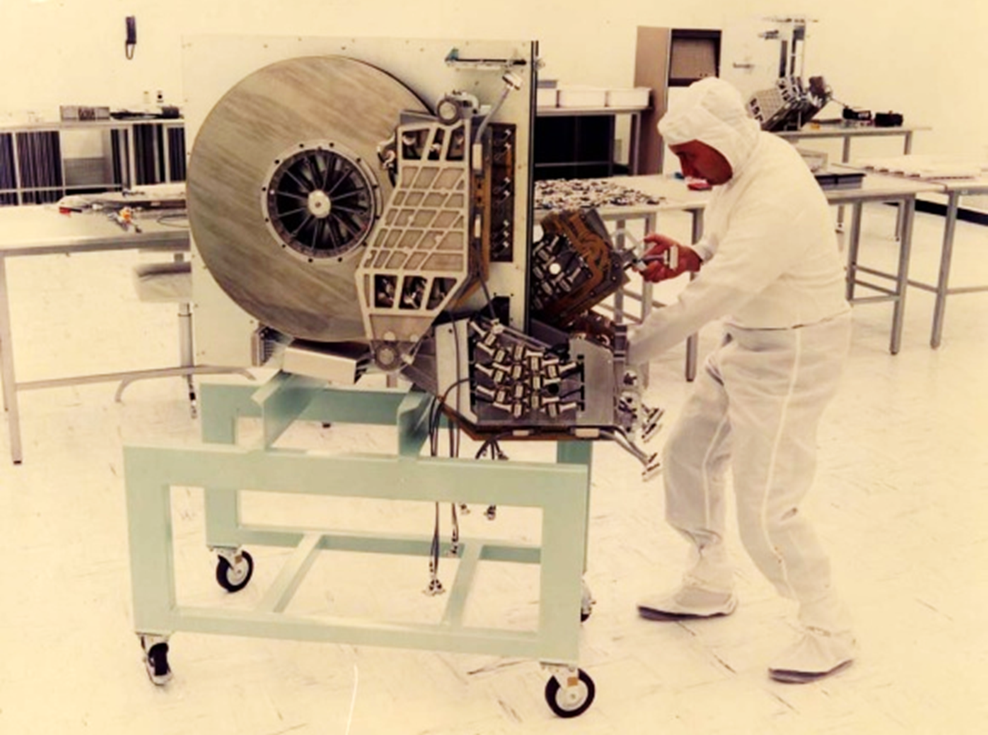
Year: 1979
Size: 250MB

Slide 21
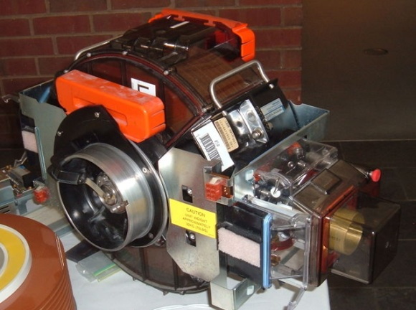
Year: 1980
Size: 2.5GB

Slide 22
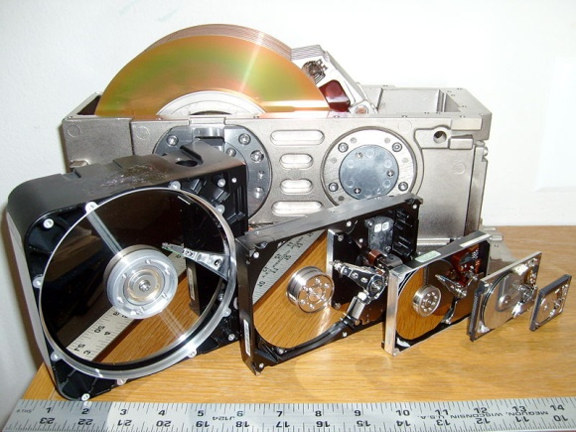
From: 2.5GB
To: 2TB
1980-2012

Slide 23
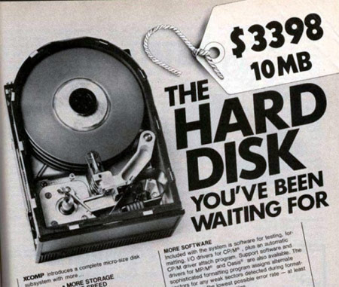
From: 2.5GB
To: 2TB
1980-2012

Slide 24
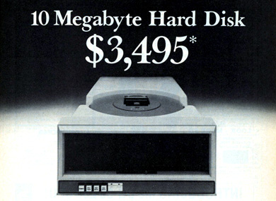
From: 2.5GB
To: 2TB
1980-2012

Slide 25
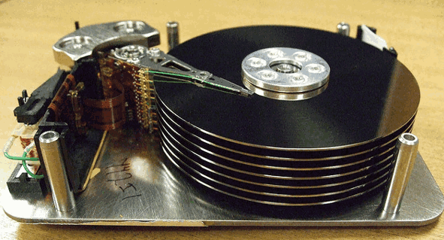

Slide 26
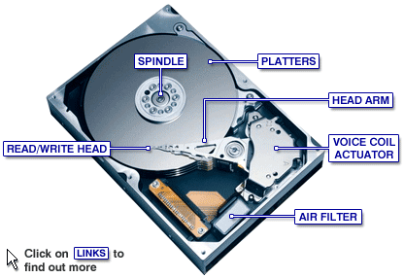

Slide 27
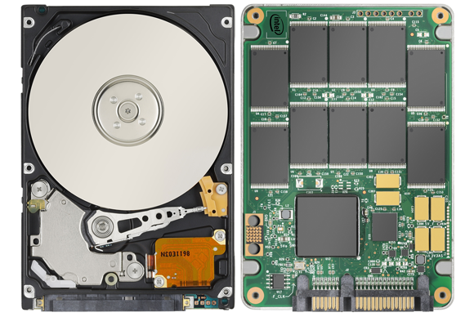
Hard drive
SSD drive

Slide 28
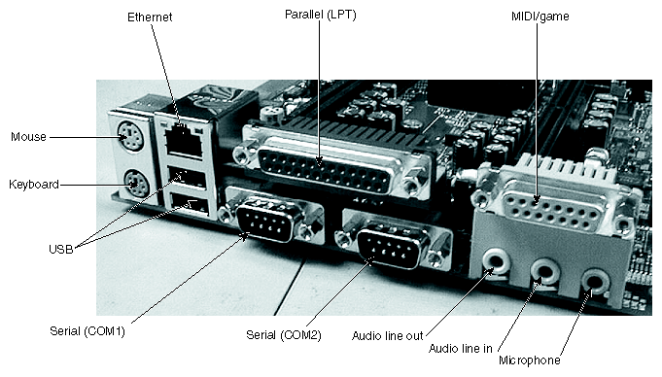
Input/Output
Keyboard
Mouse
Serial devices
Parallel devices
GPIO
I2C

Slide 29
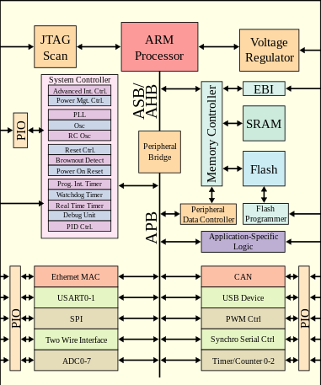
System on a Chip (SoC)

Slide 30
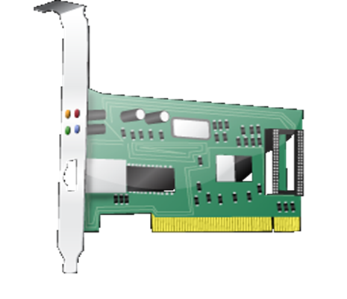
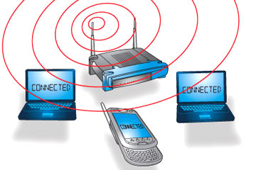
Network
Cabels
LAN Cards
Layer 1
LAN card, Repeater, HUB, Transceiver
Layer 2
LAN card, Bridge, Switch
Layer 3
Router

Slide 31
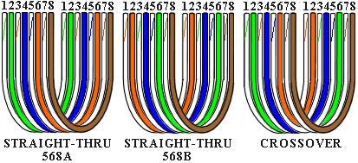
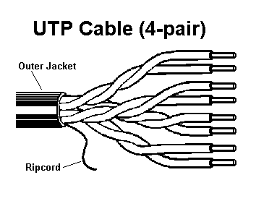
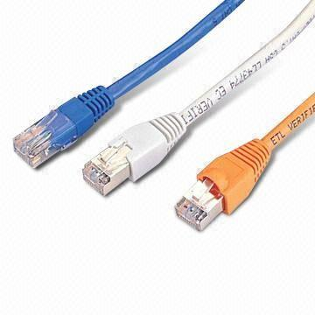
Network: UTP Cables
v

Slide 32

Hardware
http://academy.telerik.com/student-courses/software-technologies/os-windows-linux/

